Slide 1
Cyber Security
By- Samiksha Bisht

Slide 2
Content
Levels of planning
Misalignment
System security plans (SSP)
Policy development
Policy implementation

Slide 3
Levels of planning
Planning is creating action steps toward goals and then controlling them
Provides direction for the organization’s future
Allows managing resources
Optimizes the use of the resources
Coordinates the effort of independent organizational units

Slide 4
Creating a Strategic Plan
Strategic goals are translated into tasks
Specific
Measurable
Achievable
Realistic
Timely

Slide 5
Planning Levels
Strategic Planning
Five or more year focus
Strategic plan separated into strategic goals for each department
Tactical Planning
One to three year focus
Breaks strategic goals into a series of incremental objectives

Slide 6
Contd.
Operational Planning
Organize the ongoing, day-to-day performance of tasks
Includes clearly identified coordination activities across department boundaries
Communications requirements
Weekly meetings
Summaries
Progress reports

Slide 7
Strategic Plan Elements
Introduction by senior executive
Executive Summary
Mission Statement and Vision Statement
Organizational Profile and History
Strategic Issues and Core Values
Program Goals and Objectives
Management/Operations Goals and Objectives
Appendices (optional)
Strengths, weaknesses, opportunities and threats (SWOT) analyses, surveys, budgets &etc

Slide 8
Contd.
6. Be persistent
7. Make the process continuous
8. Provide meaning
9. Be yourself
10. Have fun

Slide 9
Tips For Planning
Create a compelling vision statement
Embrace the use of balanced scorecard approach
Deploy a draft high level plan early, and get input from stakeholders
Make the evolving plan visible.

Slide 10
MISALIGNEMNT
It's no secret that the frequency and intensity of data breaches is growing at an exponential rate. ... Unfortunately, these rash decisions often cause security strategy misalignment.
Misalignment -An arrangement in which the part of machine or structure o not fit together completely

Slide 11
System security Plan
The purpose of the system security plan (SSP) is to provide an overview of the security requirements of the system and describe the controls in place or planned, responsibilities and expected behavior of all individuals who access the system .

Slide 12
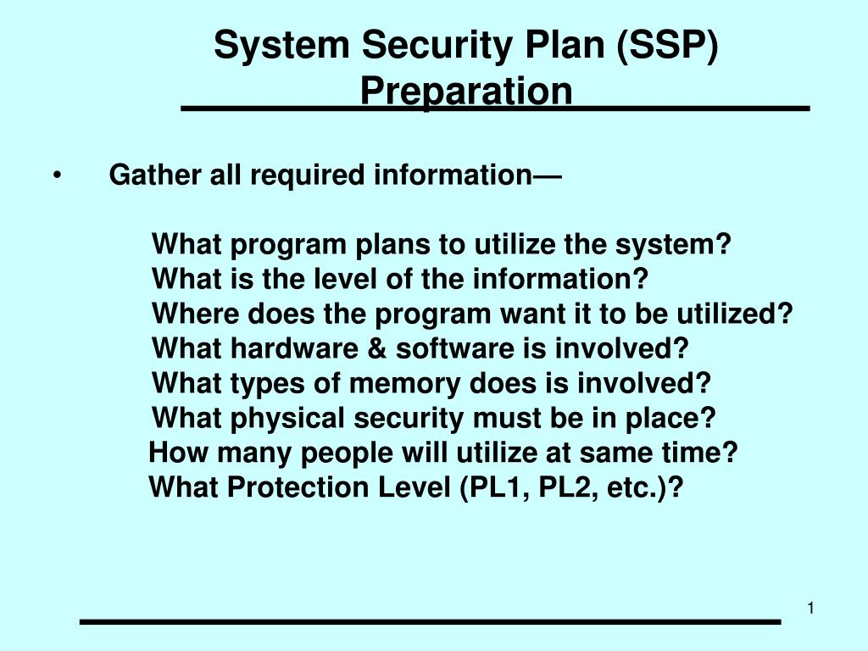
SSP

Slide 13
Security policy
By definition, security policy refers to clear, comprehensive, and well-defined plans, rules, and practices that regulate access to an organization's system and the information included in it. Good policy protects not only information and systems, but also individual employees and the organization as a whole.

Slide 14
ROLES OF SECURITY POLICY
An IT security policy should:
Protect people and information
Set the rules for expected behavior by users, system administrators, management, and security personnel
Authorize security personnel to monitor, probe, and investigate
Define and authorize the consequences of violations
Define the company consensus baseline stance on security
Help minimize risk
Help track compliance with regulations and legislation
Ensure the confidentiality, integrity and availability of their data
Provide a framework within which employees can work, are a reference for best practices, and are used to ensure users comply with legal requirements

Slide 15
How to Develop Policy
Security policy must be based on the results of a risk assessment .Findings from a risk assessment provide policy-makers with an accurate picture of the security needs specific to their organization. This information is imperative because proper policy development requires decision-makers to:
Identify sensitive information and critical systems
Incorporate local, state, and federal laws, as well as relevant ethical standards
Define institutional security goals and objectives
Set a course for accomplishing those goals and objectives
Ensure that necessary mechanisms for accomplishing the goals and objectives are in place

Slide 16
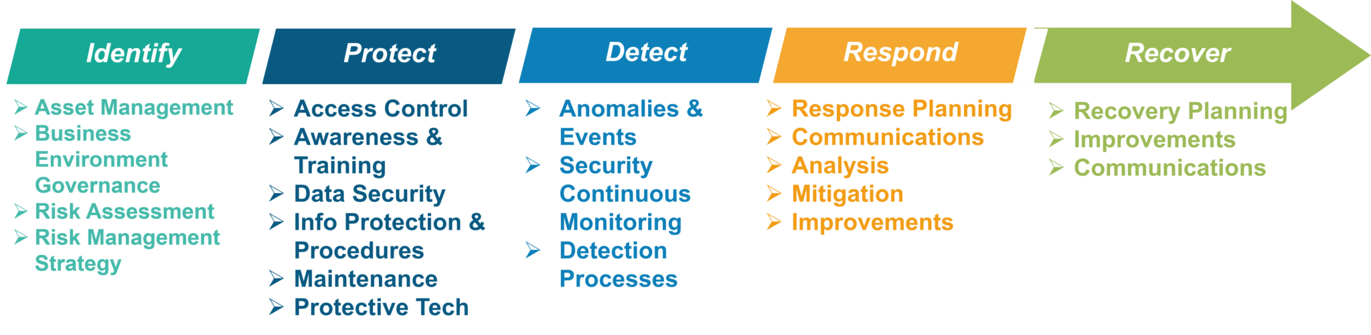
PROCESS INCLUDED

